Slide 1
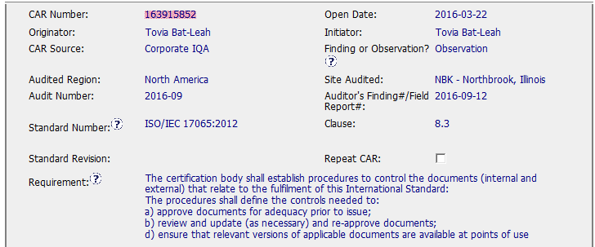
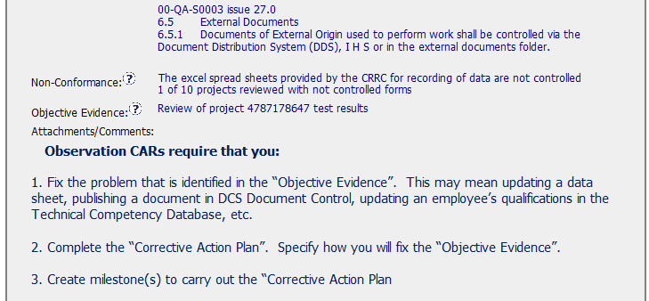
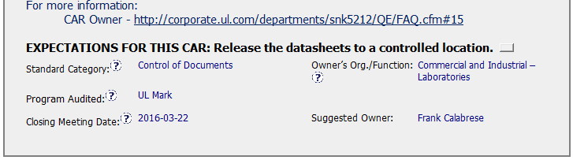
CAR 163915852

Slide 2
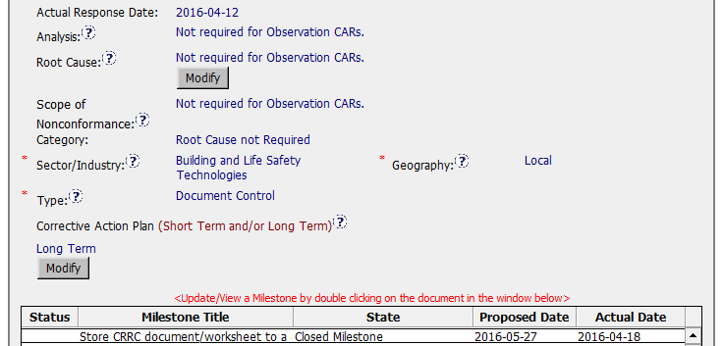
CAR 163915852
1.“N/A” entered appropriately in the “Analysis”, “Root Cause”, and “Scope “ for Observation CAR.
Other required fields were accurately completed, “Category”, “Type”, “Geography”.
1).Corrective Action Plan was not clearly stated. It is insufficient to just state “Long term” without related descriptions on what corrective actions will be taken to fix the Non-Conformance objective evidence .
2. Milestone created to achieve Corrective Action Plan.

Slide 3
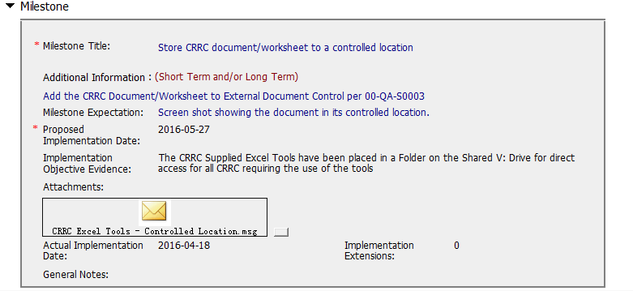
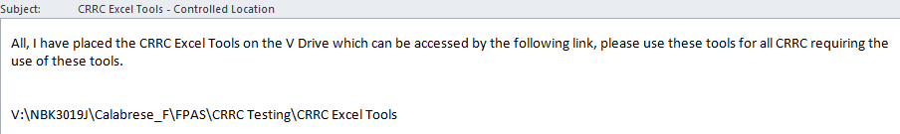
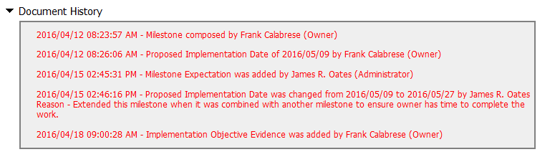
CAR 163915852
3.Implementation evidence was attached to complete the milestones expectation shown in CAR origination -‘Attachment’ filed.
2). The milestone proposed implementation date was extended , because ‘owner need time to combine with another milestone.’ It shows only one milestone created and completed on Apr. 18. Is it necessary to extend the date to May, 27 , or if there are any other concerns ? To be confirmed.

Slide 4
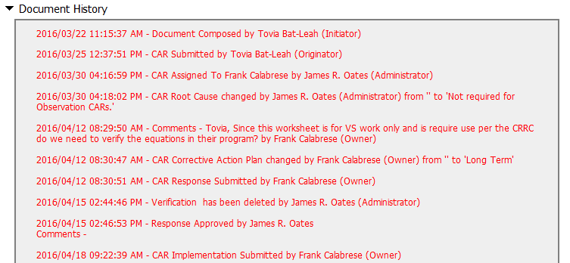
CAR 163915852
4). It show there is one concern raised by owner , is that possible to record briefly their communication and conclusion made in order to show the whole picture? To be confirmed.
4.The verification was performed immediately after acceptance of the milestone.
.

Slide 5
CAR 163915852 – CBS Check
CBS Requirements | Excellent | Moderate | Need Improve | N/A
(C) Extensions are within requirement (<30 days, 3 or less) |  | √
(T) Most appropriate ‘category’, ‘type’, ‘geography’ are selected | √
(P) Facilitates the handling of disputed CARs |  |  |  | √
(T) Acts on CARs within required timeframe | √
(C) Analysis shows clear path to root cause and scope; stakeholders identified |  |  |  | √
(C) Root cause statement is succinct, reasonable, complete (Shows ‘N/A’ for observations) | √
(C) Corrective actions fix the objective evidence and other problems found; address entire root cause and scope. For observations, they do not go beyond fixing the objective evidence |  | √
(C) Milestones address containment & owner’s verification; completed per milestone expectations | √
(P) Verification per requirements |  |  |  | √
(L) Referenced communications are attached as needed |  |  | √
(C L) Evidence of communication for overdue/escalated CARs and other pertinent concerns |  |  | √
(P) Trains other CAR Champions |  |  |  | √

Slide 6
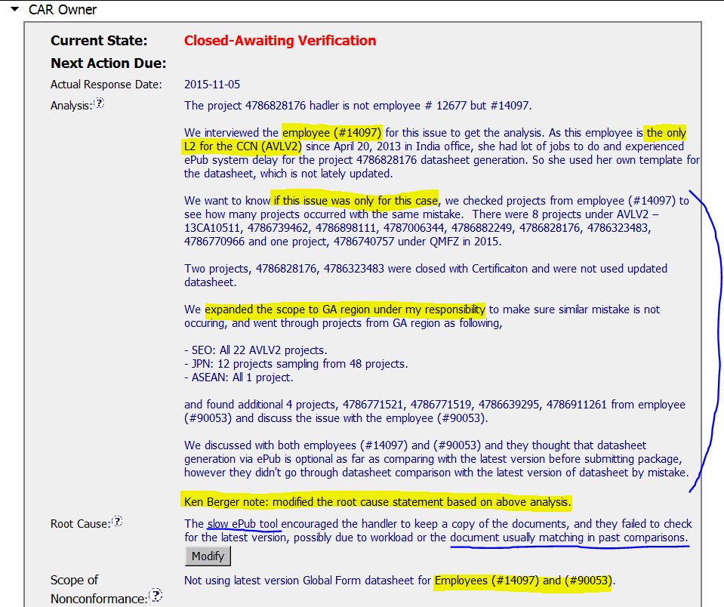
CAR 153915111 - Finding
Key stakeholder identified, but I’d recommend to include reviewer & quality manager for more effective investigation
Based on horizontal deployment concept, risk impact analysis was conducted as appropriate
Rewording of root cause statement for better description by CAR Champion
Analysis shows clear path to root cause

Slide 7
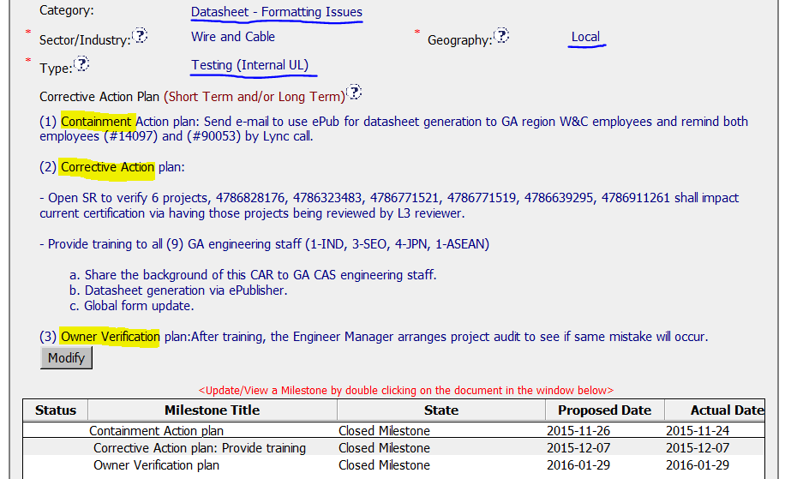
CAR 153915111 - Finding
Appropriate ‘category’, ‘geography, ‘type’ are selected as well.
Corrective Action Plan including containment, short & long-term plan
Milestone aligned with corrective action plan

Slide 8
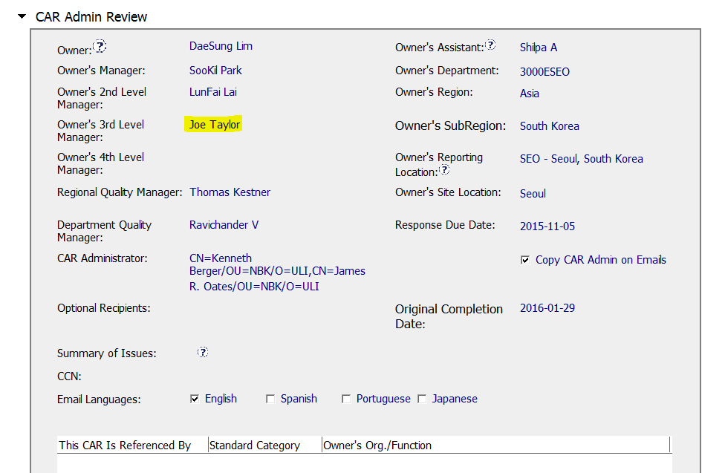
CAR 153915111 - Finding
Removing of presidents of business units from the management path

Slide 9
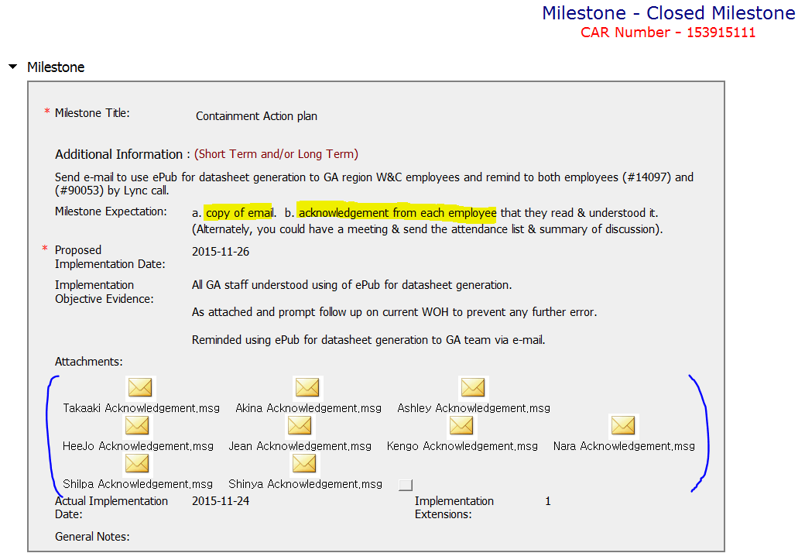
CAR 153915111 - Finding
Very clear and concrete milestone expectation from CAR Champion
Milestone completed per milestone expectation
Confirmation from all trainees on awareness related to announcement included as objective evidence

Slide 10
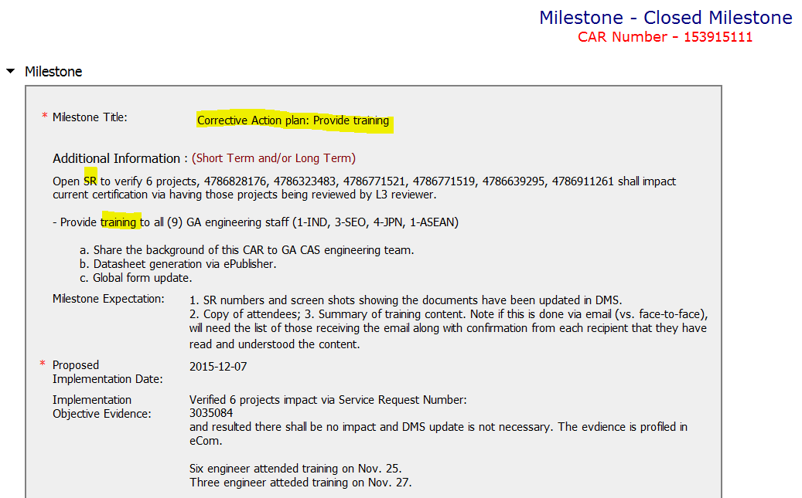
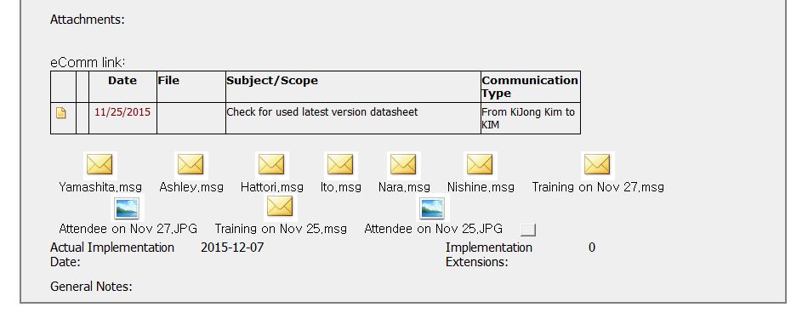
CAR 153915111 - Finding
Milestone completed per milestone expectation
Confirmation from all trainees on awareness after training included as objective evidence

Slide 11
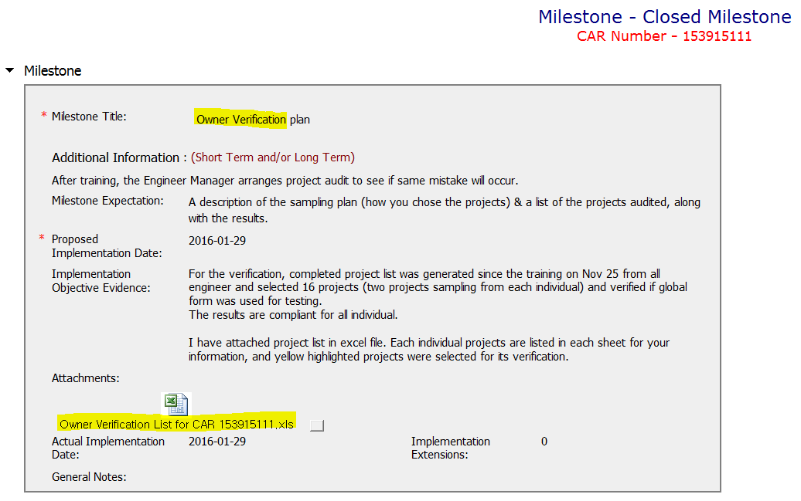
CAR 153915111 - Finding
Milestone completed per milestone expectation
Objective evidence attached as appropriate

Slide 12
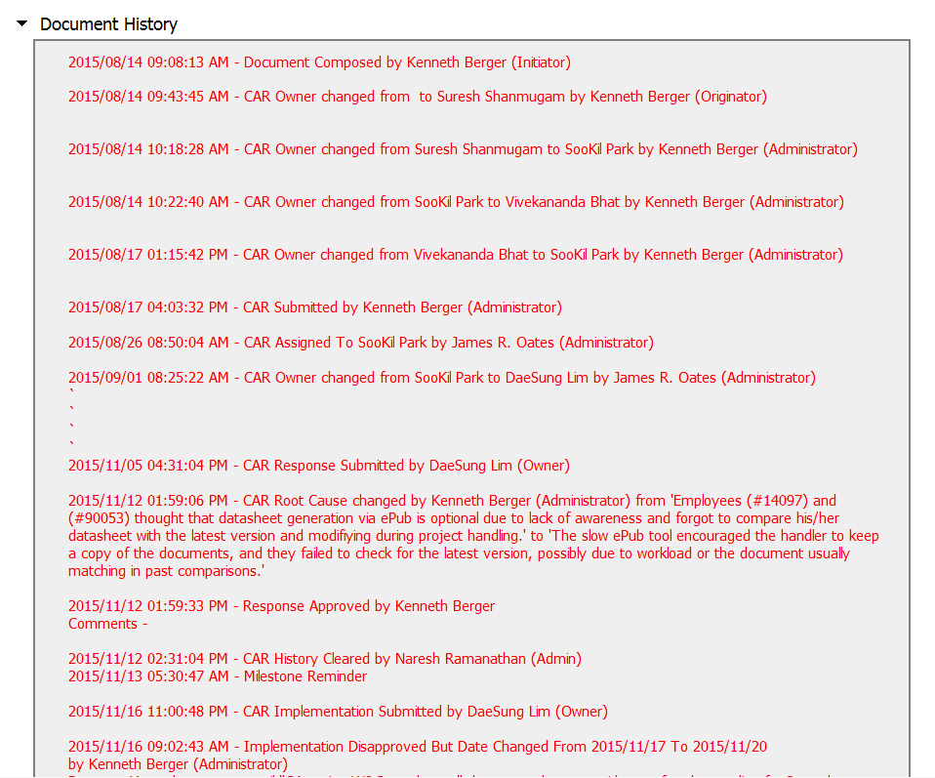
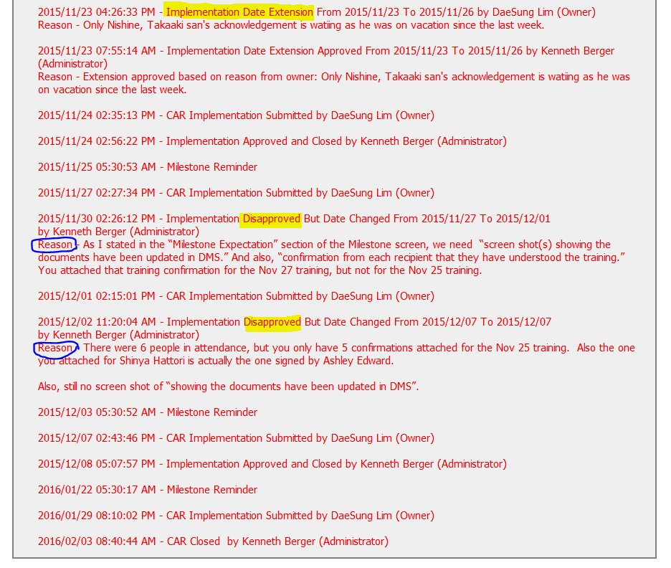
CAR 153915111 - Finding
Just one time extension for implementation
CAR Champion’s facilitation to ensure the perfection of implementation evidence

Slide 13
CAR 153915111 – CBS Check
CBS Requirements | Excellent | Moderate | Need Improve | N/A
(C) Extensions are within requirement (<30 days, 3 or less) |  |  |  | √
(T) Most appropriate ‘category’, ‘type’, ‘geography’ are selected | √
(P) Facilitates the handling of disputed CARs | √
(T) Acts on CARs within required timeframe | √
(C) Analysis shows clear path to root cause and scope; stakeholders identified |  | √
(C) Root cause statement is succinct, reasonable, complete (Shows ‘N/A’ for observations) | √
(C) Corrective actions fix the objective evidence and other problems found; address entire root cause and scope. For observations, they do not go beyond fixing the objective evidence | √
(C) Milestones address containment & owner’s verification; completed per milestone expectations | √
(P) Verification per requirements | √
(L) Referenced communications are attached as needed |  |  |  | √
(C L) Evidence of communication for overdue/escalated CARs and other pertinent concerns |  |  |  | √
(P) Trains other CAR Champions |  |  |  | √

